Slide 1
Overview: REST APIs, Swagger, and the OpenAPI specification language
http://bit.ly/OSSNAOAI

Slide 2
Overview
APIs: What all the fuss is about
API Description Languages
Swagger, OpenAPI 2.0, 3.0 & beyond
http://bit.ly/OSSNAOAI

Slide 3
All Eyes on APIs
http://bit.ly/OSSNAOAI

Slide 4

How did we get here?
Perfect Storm:
Ubiquitous, standardized web communication technology
AJAX: The web works for data
Mobile
SaaS
Integration “Big Bang”
Result: The API Economy
http://bit.ly/OSSNAOAI

Slide 5
What does the API Economy look like?
External APIs:
New Revenue Channels
New Systems of Engagement
Internal APIs:
SOAP → REST
XML → JSON
Verbs → Nouns
Centralized → Distributed
Tools!
API Design Tools
Interactive Documentation
Code Generation
Frameworks
API Testing Tools
Developer Portal
API Gateway
API Management
Mocking / Virtualization
IPaaS
API Aggregators
http://bit.ly/OSSNAOAI

Slide 6
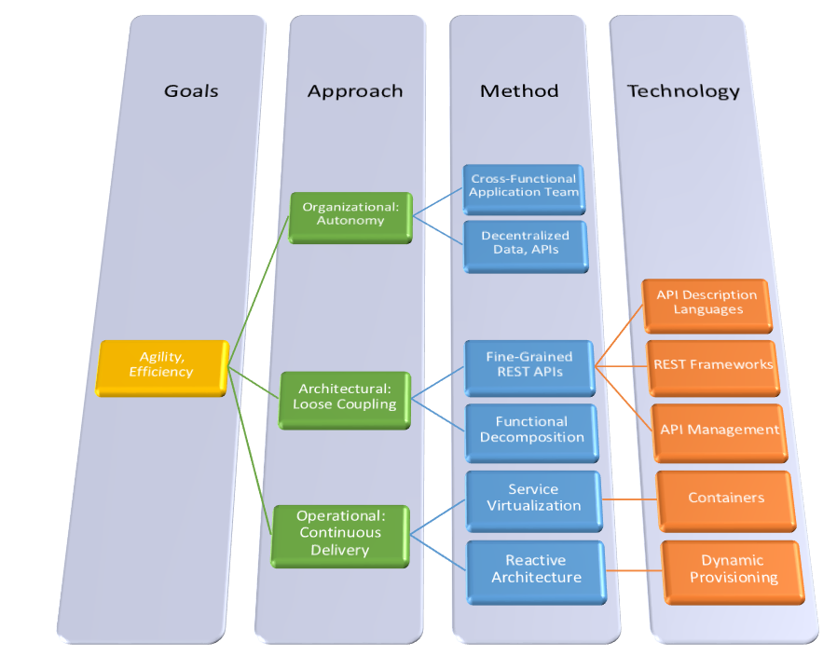
Oh, and Microservices.
What’s this about?
Componentization, not centralization
Application-Scoped
Single-Purpose, Lightweight
Autonomous, Self-Contained
http://bit.ly/OSSNAOAI

Slide 7
Oh, and Microservices.
And So…
Network & cloud infrastructure becomes the OS
Devops becomes a prerequisite
Microservice platforms for orchestration, scheduling, container lifecycle management…
Reuse is not a primary goal… yet.
http://bit.ly/OSSNAOAI

Slide 8
API Definitions and Documentation
http://bit.ly/OSSNAOAI

Slide 9
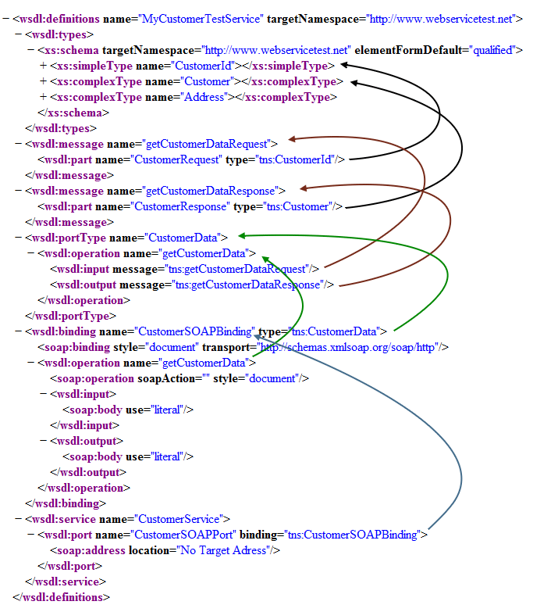

2000’s - Remember WSDL?
Web Services Definition Language
W3C Standard
Define your SOAP API contract (logical & physical)
Widely supported in language frameworks, IDEs
Complex!
XML Schema
Document-Literal, Wrapped, Basic Profile…
WS-*
http://bit.ly/OSSNAOAI

Slide 10

What About REST?
Early Days:
XML over HTTP
NoSchema™
RESTafarians – Hypermedia as religion
Do you speak HATEOAS?
Hypertext as the engine of application state
The media type tells the whole story.
http://bit.ly/OSSNAOAI

Slide 11

What About REST?
Then there was WADL…
Web Application Description Language
W3C proposal, never a recommendation
XML-Based
Not widely adopted
http://bit.ly/OSSNAOAI

Slide 12

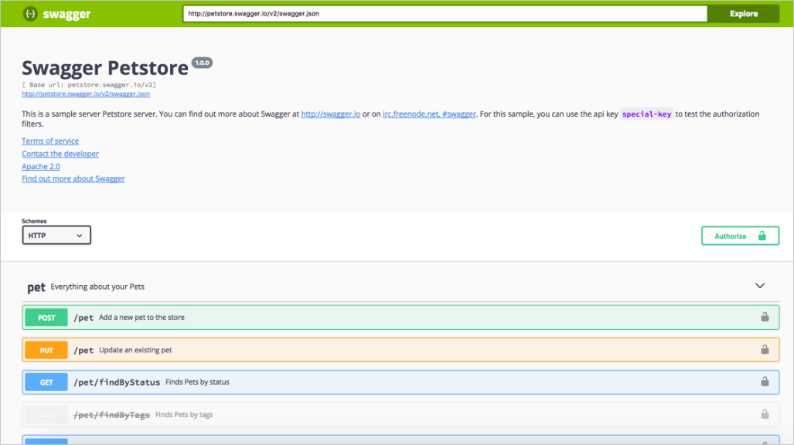

2011 – Swagger: The First Generation
Swagger – First Generation
Aimed at the API documentation problem – how do I keep the docs in sync?
Code-first, with annotations
No intermediate language
Runtime with integrated sandbox testing
http://bit.ly/OSSNAOAI

Slide 13

2011 – Swagger: The First Generation
Swagger – First Generation
Aimed at the API documentation problem – how do I keep the docs in sync?
Code-first, with annotations
No intermediate language
Runtime with integrated sandbox testing
“Why WADL when you can Swagger?”
- Tony Tam
http://bit.ly/OSSNAOAI

Slide 14
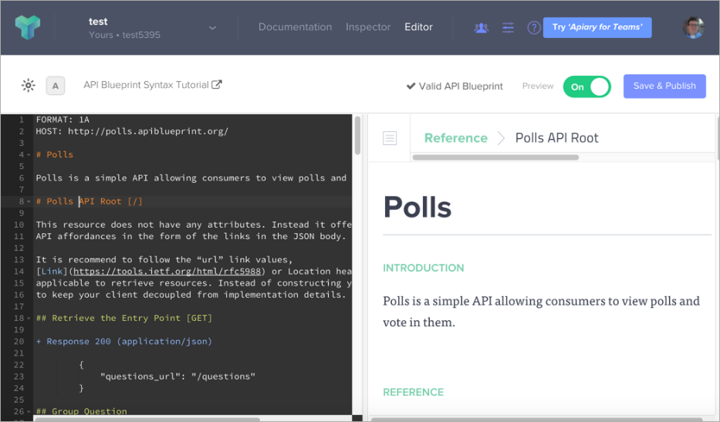

2012? API Blueprint
Apiary introduces API Blueprint
Based on Markdown
Online Editor
Hosted Documentation
Code Generation
Conformance Testing
Swagger Introduces JSON Syntax, Editor & Codegen
http://bit.ly/OSSNAOAI

Slide 15

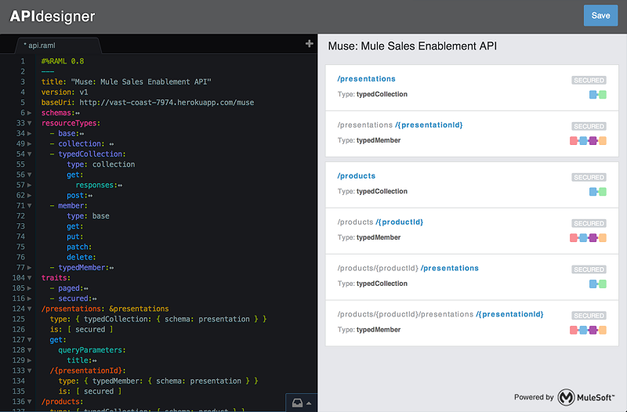
2013-14: RAML
MuleSoft introduces REST API Modeling Language (RAML)
YAML-Based
Traits
Online editors…
Not as widely adopted
Swagger introduces 2.0 spec
YAML syntax, new editor, codegen, UI, etc.
Improved language model
http://bit.ly/OSSNAOAI

Slide 16

2015: OpenAPI
Swagger 2.0 Specification becomes the OpenAPI Specification (OAS) 2.0
SmartBear acquires Swagger
Contributes language spec to new Open API Initiative (OAI), formed under the Linux Foundation
Founding members 3Scale, Apigee, Capital One, Google, IBM, Intuit, Microsoft, PayPal and Restlet
Retains Swagger brand name for its Commercial & Open Source software
http://bit.ly/OSSNAOAI

Slide 17
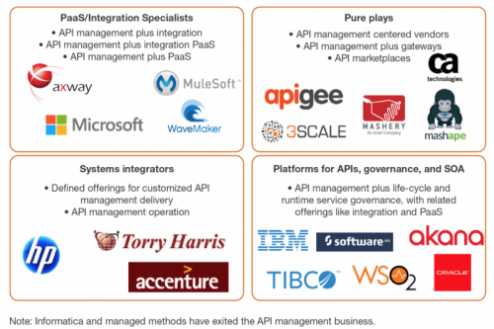
2016: Transitional Year
RAML 0.8 → 1.0 (Announced late 2015)
Oracle acquires Apiary (Announced Jan 2017)
OpenAPI begins work on 3.0 spec
API tools market expanding & evolving
http://bit.ly/OSSNAOAI

Slide 18

2017: OpenAPI 3.0
More reusable components
More complete support for JSON Schema
Content negotiation
Enhanced Security Definitions
More flexible examples
Callbacks
Links
Multiple Servers
Industry Converges around Open API Initiative
MuleSoft joins
RepreZen joins
33 members as of May 2018
http://bit.ly/OSSNAOAI

Slide 19
2018: OpenAPI 3.x
OpenAPI 3.0 tools still catching up
New API Paradigms Emerging
GraphQL
gRPC
Async API
IoT Standards…
OpenAPI 3.x topics under discussion:
Alternative Schemas
Conformance Testing & Certification
Overlays
Encryption/Signing
Client Certificates
http://bit.ly/OSSNAOAI

Slide 20
Swagger or OpenAPI?
A collection of open source and commercial software
A cool way to show API documentation with a built-in “Try it out” button.
A brand name trademark owned by SmartBear
Swagger
OpenAPI Specification (OAS)
An industry-standard language for describing REST APIs
(Swagger UI)
OpenAPI Initiative (OAI)
An industry consortium formed under the Linux Foundation
http://bit.ly/OSSNAOAI

Slide 21
Swagger or OpenAPI?
Swagger
OpenAPI Specification (OAS)
A collection of open source and commercial software
An industry-standard language for describing REST APIs
A cool way to show API documentation with a built-in “Try it out” button.
(Swagger UI)
OpenAPI Initiative (OAI)
A brand name trademark owned by SmartBear
An industry consortium formed under the Linux Foundation
http://bit.ly/OSSNAOAI

Slide 22
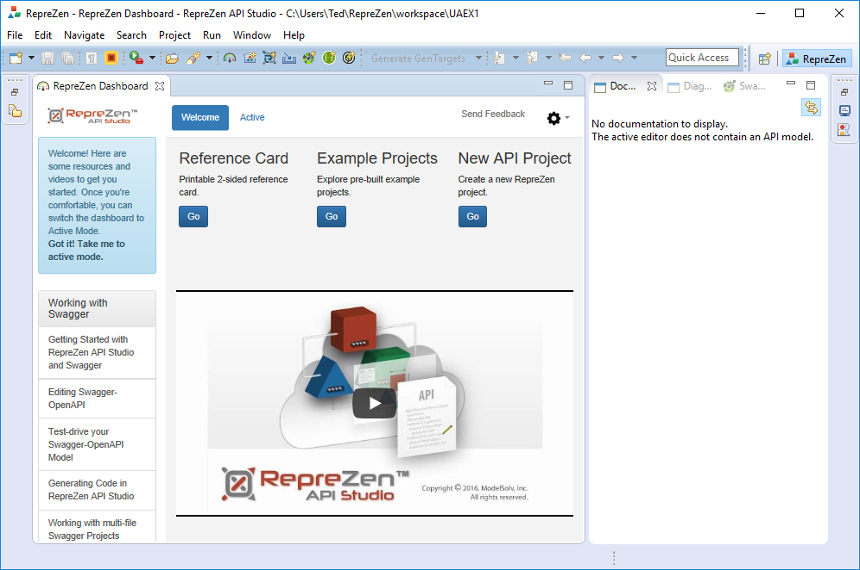
Are we ready to roll?
API Studio installed?
Corporate license or trial activated?
API Studio running with dashboard displayed?
Hint: Keep the Reference Card Handy!

Slide 23
OpenAPI 2.0 Fundamentals

Slide 24
The OpenAPI Specification Language
Specifications are maintained on GitHub: https://github.com/OAI/OpenAPI-Specification
Specified as an object model.
Two syntaxes are supported: JSON and YAML.
A JSON Schema is provided for tool support & partial validation. (Currently for v2. Schema for v3 is in progress.)
The human-readable specification is definitive.

Slide 25
About YAML
The preferred syntax for OpenAPI 2.0 editing and human consumption.
Acronym: “YAML Ain’t Markup Language”
A general-purpose structured language
White space is significant. Indents define block scope.
Designed with explicit support for JSON
Provides a JSON “Schema,” which is more like a “profile.”
Valid JSON is generally valid YAML.
YAML also supports more efficient and readable block syntax, without quotes, commas, curly braces, etc.
YAML can be used as a shorthand “JSON DSL.”

Slide 26
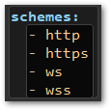
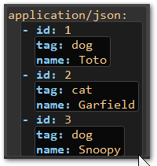
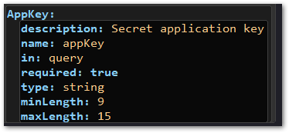
Essential YAML Structures
String Array
Object or Map with Primitive Properties
Object Array

Slide 27
YAML Multi-Line Strings (most common)
Style | Example | Behavior
Plain | Key: this is my very very very long string → this is my very very very long string | Constructs a single-line string with no newline characters. Can begin on the same line as the key, or with additional newlines first. No escaping, no # or : combinations.
Folded | Key: > this is my very very very long string → this is my very very very long string\n | Allows characters such as \ and " without escaping. Removes single newlines within the string (but adds one at the end), converts double newlines to singles.
Literal | Key: | this is my very very very long string → this is my very very very\nlong string\n | Allows characters such as \ and " without escaping. Turns every newline within the string into a literal newline, and adds one at the end:

Slide 28
The OpenAPI Object

Slide 29
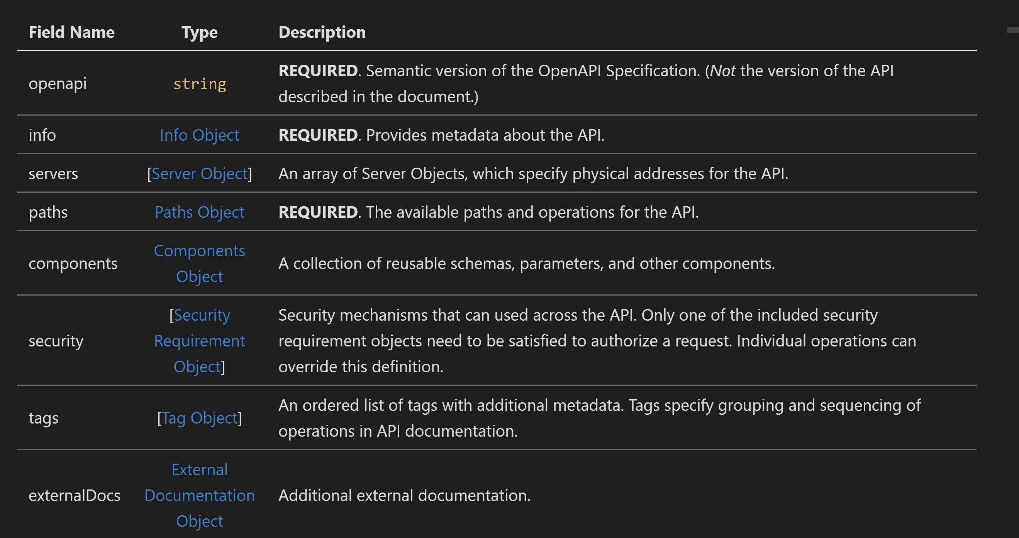
The OpenAPI Object

Slide 30
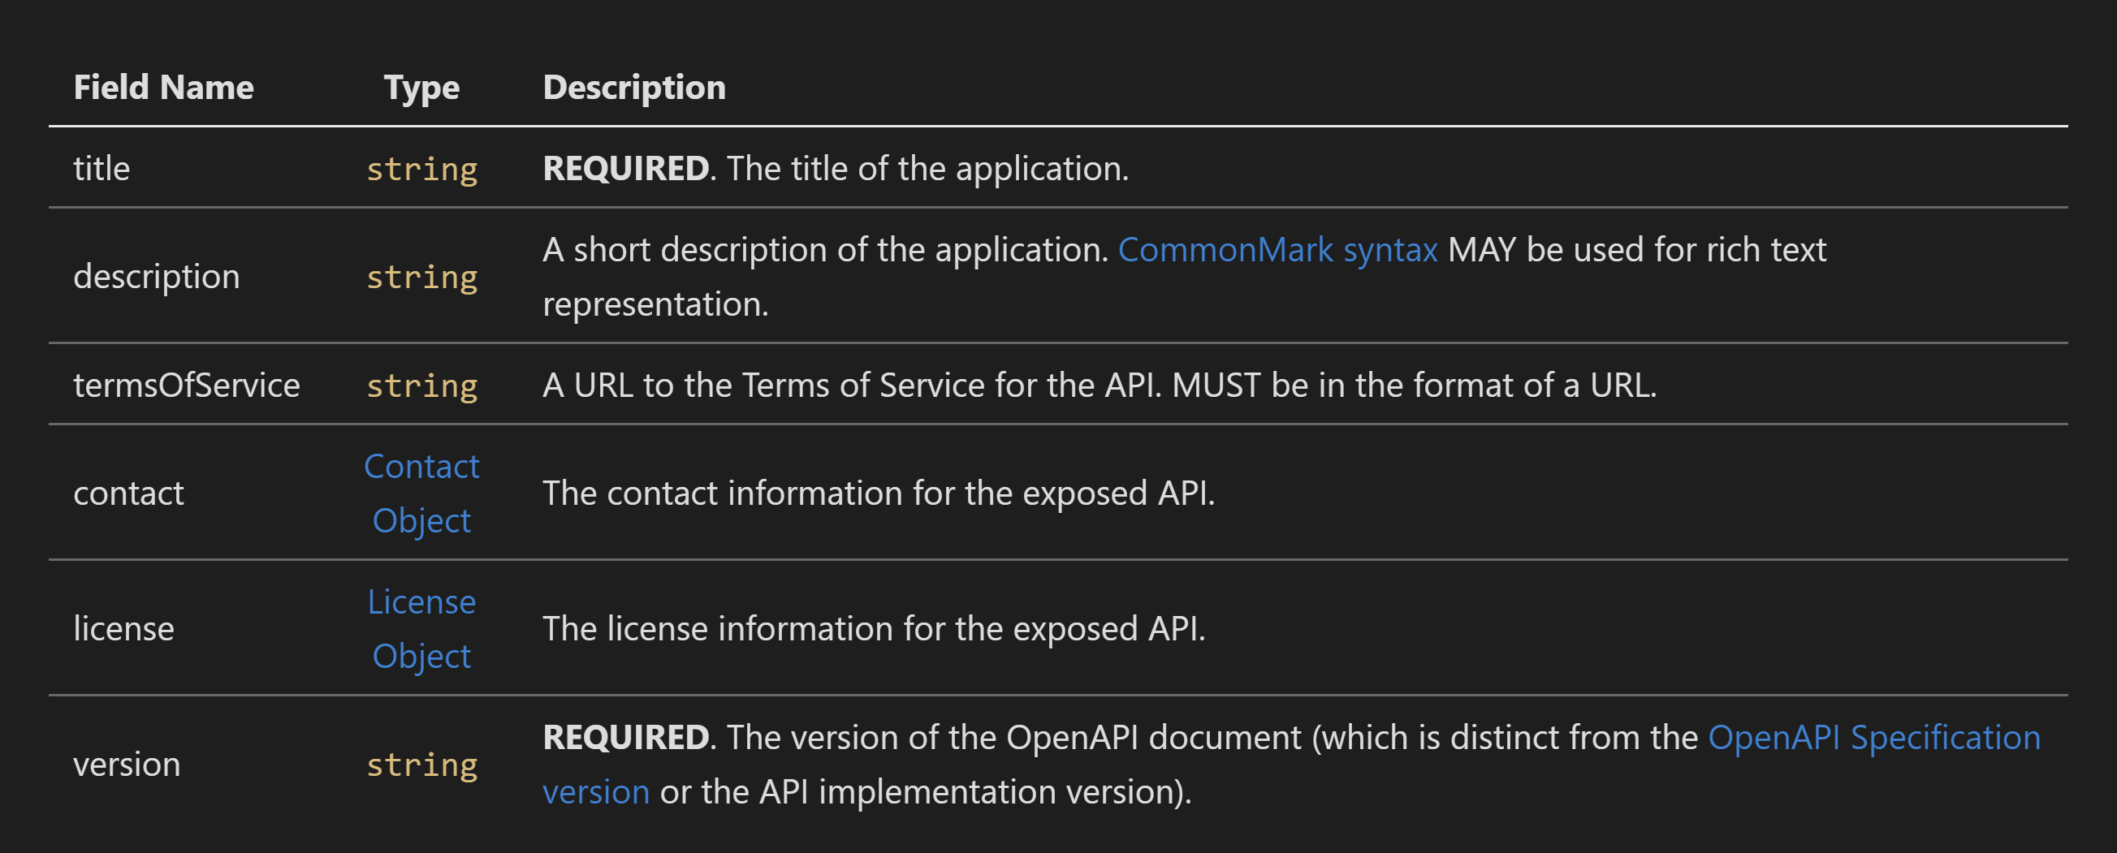
The Info Object

Slide 31
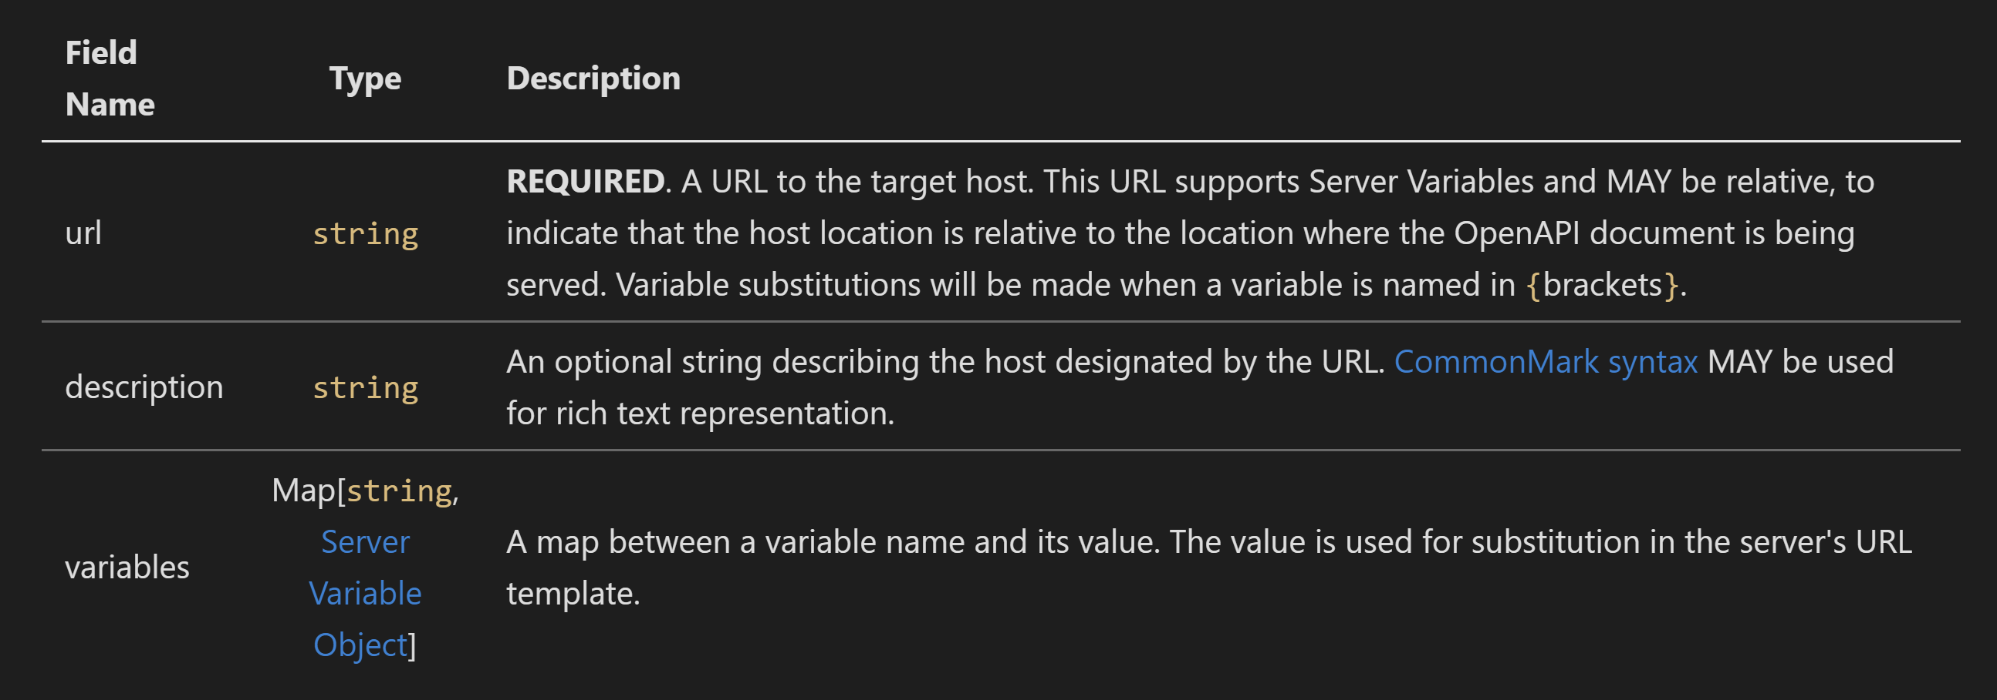
Server Object

Slide 32
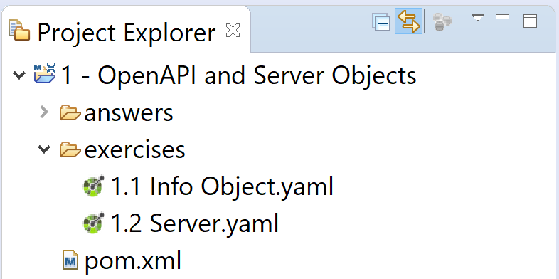
Exercises: OpenAPI Info and Server Object
Complete the exercises in the folder: 1 – OpenAPI and Server Object/exercises

Slide 33
Core API Definitions
Paths Object contains essential API definitions:
Path Item a URL template representing one or more resources.
Operation an action allowed on a path item, using HTTP methods.
Parameter information passed to the operation as part of a request.
Request Body specifies the request payload
Security requirement authentication and authorizations required for access.
Response a message returned by the operation to the client.

Slide 34
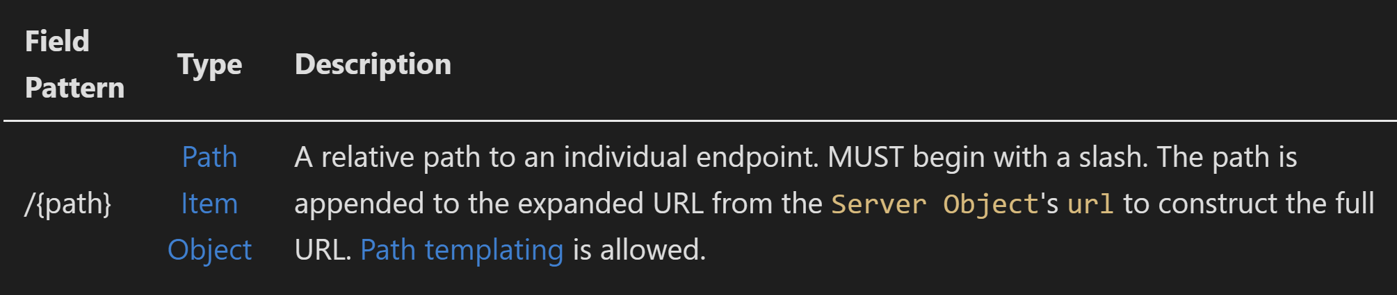
Paths Object
A map of relative URL templates to path item definitions.
A path like /orders defines a singleton resource.
A path template like /orders/{orderID} defines a set of resources. A corresponding path parameter must be defined for each template placeholder.

Slide 35
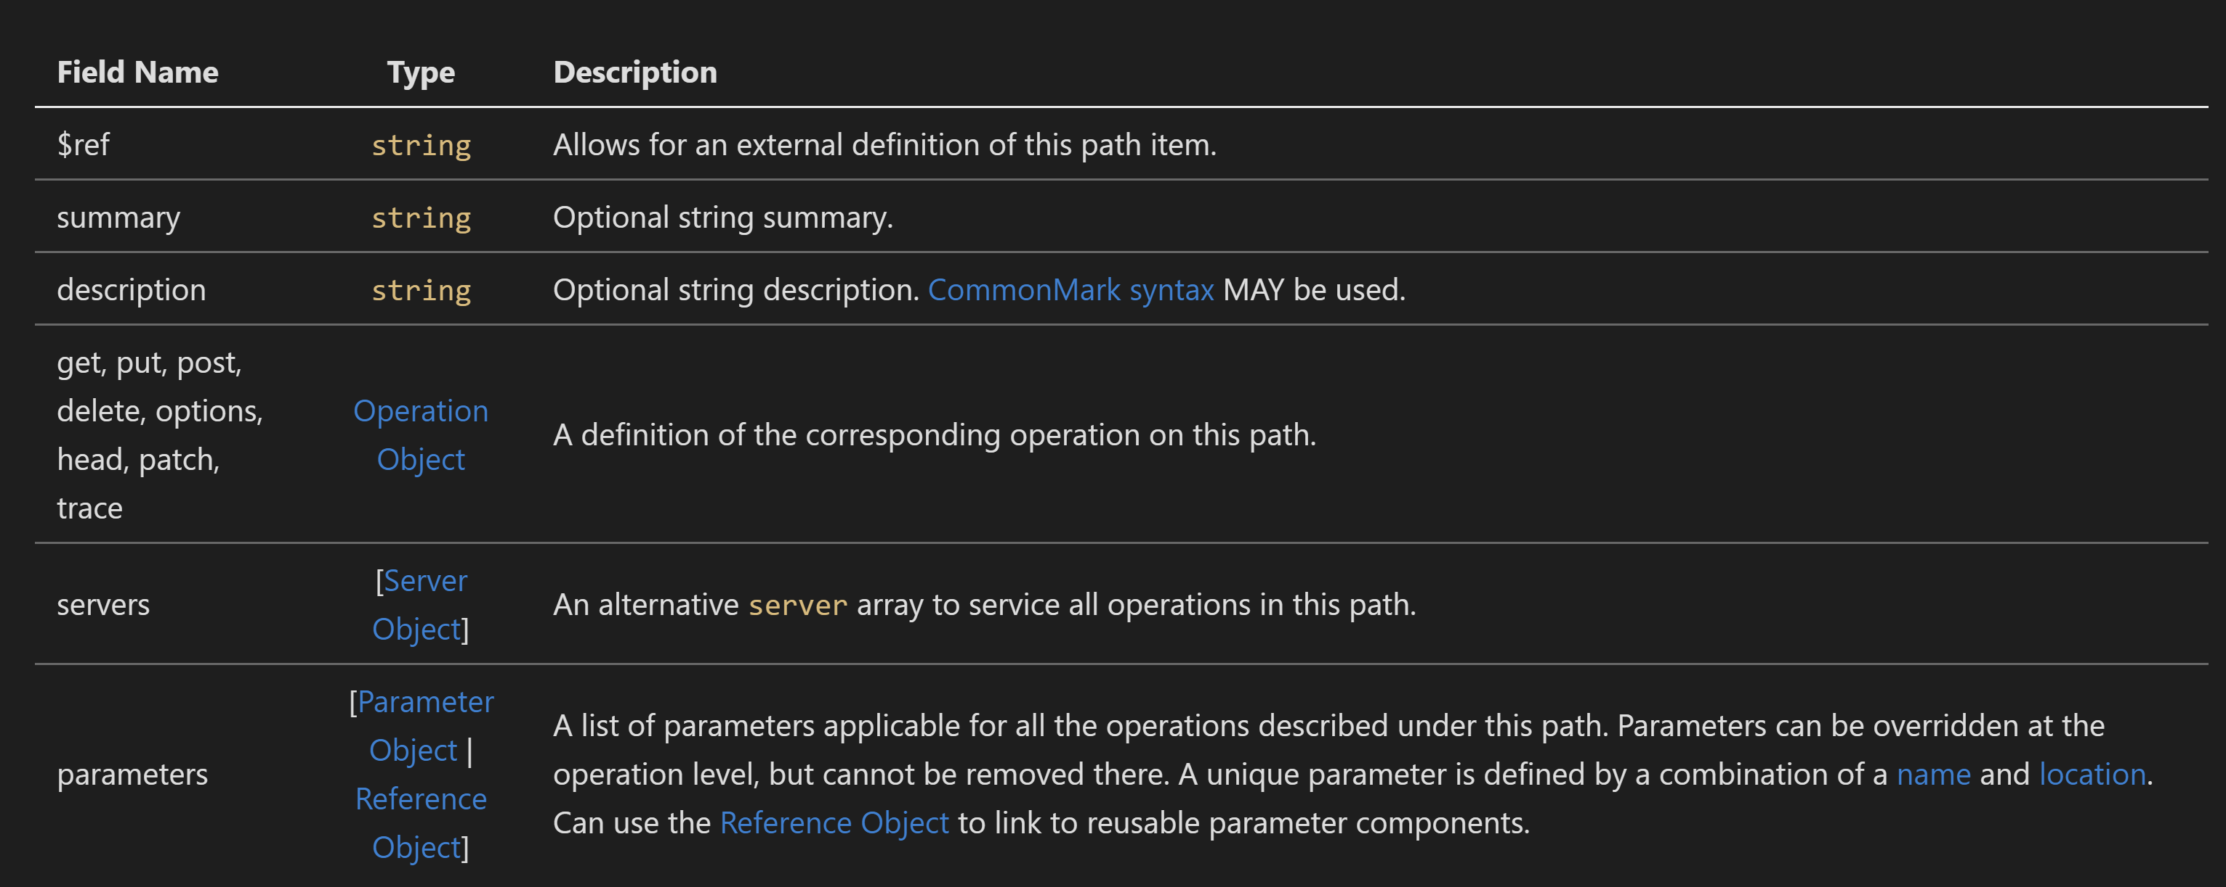
Path Item Object

Slide 36
Parameters
Information passed in a request:
Parameter Object unit of information passed to the operation.
Parameter may have schema and examples, or may have content, but not both.
For Simple Cases:
Schema Object Describes the data type of the parameter
Example Object Single or multiple example parameter values
For Complex Cases:
Media Type A Schema and optional examples for a particular media type. Containing content map may have multiple media type objects.

Slide 37
Path Parameters
A non-body parameter with in: path
MUST have required: true
MUST correspond 1:1 with a variable expression in the path
SHOULD be declared at path item level
It applies to all methods within the path item.
It MAY be added or overridden (but not removed) at operation level.
The path item represents a set of resources.
/pets/{petId}:
get:
parameters:
- name: petId
in: path
required: true
description:
The ID of the pet to retrieve.
type: string

Slide 38
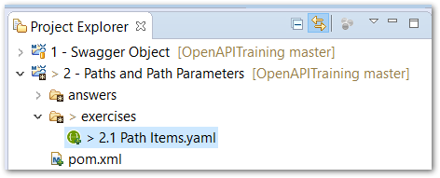
Exercise: Path Items & Path Parameters
Complete the exercises in the folder: 2 – Paths and Path Parameters

Slide 39
OpenAPI Operations and HTTP Methods
HTTP defines a uniform interface: a standardized set of methods for each resource.
Methods have predefined semantics.
Important to match the intended behavior of an operation to the appropriate HTTP method.
method | safe | idempotent | cacheable
GET | ✔ | ✔ | ✔
POST | ✘ | ✘ | ✘
PUT | ✘ | ✔ | ✘
PATCH | ✘ | ✘ | ✘
DELETE | ✘ | ✔ | ✘
HEAD | ✔ | ✔ | ✔
OPTIONS | ✔ | ✔ | ✘

Slide 40
HTTP Method Semantics
Safe Read-only. Does not change the state of the server.
Idempotent Repeated requests will have the same effect as first request.
Cacheable Responses may be cached, according to HTTP rules. (See rfc7234.)
method | safe | idempotent | cacheable
GET | ✔ | ✔ | ✔
POST | ✘ | ✘ | ✘
PUT | ✘ | ✔ | ✘
PATCH | ✘ | ✘ | ✘
DELETE | ✘ | ✔ | ✘
HEAD | ✔ | ✔ | ✔
OPTIONS | ✔ | ✔ | ✘

Slide 41
Common HTTP Methods
method | description | safe | idem. | cache.
GET | "requests transfer of a current selected representation for the target resource." | ✔ | ✔ | ✔
POST | "requests that the target resource process the representation enclosed in the request according to the resource's own specific semantics." | ✘ | ✘ | ✘
PUT | "requests that the state of the target resource be created or replaced with the state defined by the representation enclosed in the request message payload." | ✘ | ✔ | ✘
PATCH | "requests that a set of changes described in the request entity be applied to the resource identified by the Request-URI." | ✘ | ✘ | ✘
DELETE | "requests that the origin server remove the association between the target resource and its current functionality." | ✘ | ✔ | ✘
HEAD | "is identical to GET except that the server MUST NOT send a message body in the response (i.e., the response terminates at the end of the header block)." | ✔ | ✔ | ✔
OPTIONS | "requests information about the communication options available on the request/response chain identified by the effective request URI." | ✔ | ✔ | ✘

Slide 42
Response
Response Object Response from the service.
Header Object: HTTP response headers.
Structure is like Parameter, but without name and in properties. Describes the data type of the parameter
Like parameter, may have schema and examples, or may have content, but not both.

Slide 43
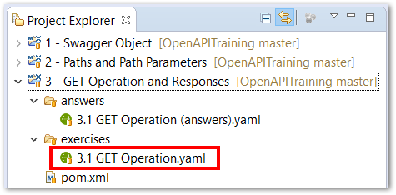
Exercise: GET Operation and Response
Complete the exercises in the folder: 3 – GET Operation and Responses

Slide 44
Query Parameters
A non-body parameter with in: query
Passed on the query string with the convention: …resource?param1=val1&param2=val2…
May be required or optional.
May be specified at path item level, or at operation level.
Can be used to specify a query protocol, or to pass supplementary request data, e.g. language, format.
Visible as part of the URL, easy to send the request from a browser or other simple client.
paths:
/pets:
get:
summary: List all pets
operationId: listPets
parameters:
- name: limit
in: query
description: >
How many items to return
at one time (max 100)
required: false
schema:
type: integer
format: int32
Example request URL:
http://petstore.swagger.io/pets?limit=50

Slide 45
Header Parameters
A non-body parameter with in: header
Passed in the request header.
HTTP standardizes many headers in rfc4229 (and linked RFCs)
IANA maintains permanent and provisional registries of these and other standard header names.
You can also use custom header names.
May be required or optional.
May be specified at path item level, or at operation level.
Not visible as part of the URL, easy to send the request from a browser or other simple client.
paths:
/pet_medications:
get:
parameters:
- name: Accept-Language
in: header
schema:
type: string
required: false
description: >
Indicates the set of natural languages
that are preferred in the response.

Slide 46
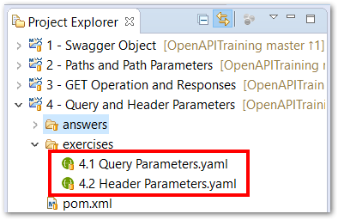
Exercise: Query and Header Parameters
Complete the exercises in the folder: 4 – Query and Header Parameters

Slide 47
Request Body
Request Body Object Specifies the request message payload.
Media Type Object A Schema and optional examples for a particular media type. Containing content map may have multiple Media Type Objects.
Schema Object The physical schema describing the message payload when using the containing media type.
Encoding Object Optionally overrides the default wire representation of a given property when using the containing media type.

Slide 48
About Schema Object
Taxpayer:
type: object
required:
- taxpayerID
- familyName
properties:
taxpayerID:
type: string
pattern: ^\d{3}-?\d{2}-?\d{4}$
familyName:
type: string
givenNames:
type: array
items:
type: string
maritalStatus:
$ref:
"#/definitions/MaritalStatusEnum"
address:
type: object
properties:
streetAddress:
type: string
city:
type: string
stateOrProvince:
type: string
Used in OpenAPI to describe request and response message bodies.
Based on JSON Schema (json-schema.org)
Supports a subset of native JSON Schema properties.
Adds a few OpenAPI-specific properties.
Describes JSON or any structured content that maps to JSON
Constraint-based language
By default, any valid JSON value is allowed.
Describes primitive values, objects, and arrays
Highly recursive, using subschemas to describe:
Array elements
Property values
Operands in Boolean assertions: allOf, anyOf, not
Modular, using JSON Reference ($ref properties)

Slide 49
What are Schemas for?
Taxpayer:
type: object
required:
- taxpayerID
- familyName
properties:
taxpayerID:
type: string
pattern: ^\d{3}-?\d{2}-?\d{4}$
familyName:
type: string
givenNames:
type: array
items:
type: string
maritalStatus:
$ref:
"#/definitions/MaritalStatusEnum"
address:
type: object
properties:
streetAddress:
type: string
city:
type: string
stateOrProvince:
type: string
Documentation
An essential part of the API contract.
Doc formats help to present, visualize and navigate schemas.
Code Generation
Generate DTO classes as annotated POJOs, POCOs, etc.
Validation
Client and/or server can validate requests and/or responses
Message Serialization/Deserialization
Using generated DTOs and/or dynamic code.
Testing
Test API responses against the data contract
Tooling
Generate examples
Validate system- or human-generated examples
Provide forms for structured input

Slide 50
Taxpayer:
type: object
required:
- taxpayerID
- familyName
properties:
taxpayerID:
type: string
pattern: ^\d{3}-?\d{2}-?\d{4}$
familyName:
type: string
givenNames:
type: array
items:
type: string
maritalStatus:
$ref:
"#/definitions/MaritalStatusEnum"
address:
type: object
properties:
streetAddress:
type: string
city:
type: string
stateOrProvince:
type: string
Schema
Object schema
Required properties – a list of names defined in properties.
Primitive-typed subschema with pattern (regular expression) constraint
Message
{
"taxpayerID": "222-33-4444",
"familyName": "Nelson",
"givenNames":
[
"Louis",
"Phillip"
],
"maritalStatus": "Married",
"address":
{
"streetAddress":
"123 Sesame St.",
"city": "St. Louis",
"stateOrProvince": "MO" }
}
Array-typed subschema
Items subschema constrains the elements of the array
JSON Reference to another schema in the same document, used as the subschema for maritalStatus
Object-typed subschema

Slide 51
Reusable Components
OpenAPI allows $ref properties in certain contexts.
JSON Reference specifies reference semantics & rules using relative or absolute URL.
JSON Pointer specifies the fragment syntax to locate an object within a resource.
Components Object organizes reusable component objects within an OpenAPI document. $ref properties may refer to #/components/[objectType]/[objectName] in the current document, in other documents, or to objects in a completely different location.

Slide 52
JSON Reference Objects ($ref properties)
Location from Referring Document
Internal
External
Reference Mode
Relative
Absolute
Referent Document
OpenAPI Document
JSON Schema
Other JSON or YAML File
Reference Level
Resource Root (JSON Reference URL Only)
Nested/Contained (JSON Pointer Fragment)
Referent Format
JSON
YAML

Slide 53
Inline Schema
Referenced Schema
paths:
/pet_medications:
get:
responses:
'200':
description: OK
content:
application/json:
schema:
type: object
required:
- id
properties:
id:
type: string
name:
type: string
dosage:
type: number
paths:
/pet_medications:
get:
responses:
'200':
description: OK
content:
application/json:
schema:
$ref: "#/definitions/PetMedications"
components:
schemas:
PetMedications:
type: object
required:
- id
properties:
id:
type: string
name:
type: string
dosage:
type: number

Slide 54
Exercise: Request Body and Schema
Complete the exercises in the folder: 5 – Body Parameters and Schemas

Slide 55
Schema Object Fields (common to all schemas)
Field Name | Type | Description
type | string | "null", "boolean", "object", "array", "number", or "string"
title | string | A brief title describing this schema.
description | string | Description of the schema. May include markdown.
default | (any) | Default value for this schema. Should be valid against the schema.
enum | [(any)] | List of finite values. Each should be valid against the schema.
allOf | [Schema Object] | List of subschemas, or schema references. The instance is only valid if it conforms to all of the subschemas in the list.
externalDocs | External Documentation Object | External documentation describing the schema.
example | (any) | An example instance value. Should conform to the schema.

Slide 56
Schema Object Fields (for object-typed schemas)
Field Name | Type | Description
maxProperties | integer | Maximum number of properties that can have values.
minProperties | integer | Minimum number of properties that must have values.
required | [string] | List of required property names, each defined in the properties object.
properties | map<string, schema> | Properties defined in an object schema. Key is the property name.
additionalProperties | Schema Object | boolean | Subschema for additional properties, or FALSE if none allowed.
discriminator | string | Property name used to differentiate between subtypes.

Slide 57
Schema Object Fields (for properties of object-typed schemas)
Field Name | Type | Description
readOnly | boolean | MAY be sent in response, but MUST NOT be sent in request.
xml | XML Object | Adds metadata to describe an XML representation format.
Schema Object Fields (for array-typed schemas)
Field Name | Type | Description
items | Schema Object | Reference | A subschema that applies to elements of the array.
minItems | integer | Minimum number of items the array must contain.
maxItems | integer | Maximum number of items the array may contain.
uniqueItems | boolean | If true, values in the array must be unique. (Default is false.)

Slide 58
Schema Object Fields (for primitive-typed schemas)
Field Name | Type | Description
format | string
maximum | number | Maximum numeric value, inclusive
exclusiveMaximum | boolean | Maximum numeric value, exclusive
minimum | number | Minimum numeric value, inclusive
exclusiveMinimum | boolean | Minimum numeric value, exclusive
maxLength | integer | Maximum string length
minLength | integer | Minimum string length
pattern | string | Regular expression that the string value must match
multipleOf | number | The value of the numeric property must be a multiple of the given multipleOf value

Slide 59
Primitive schemas MAY specify a format. It can be a user-defined format name, or one of these predefined formats:
Formats
Common Name | Type | Format | Comments
integer | integer | int32 | signed 32 bits
long | integer | int64 | signed 64 bits
float | number | float
double | number | double
string | string
byte | string | byte | base64 encoded characters
binary | string | binary | any sequence of octets
boolean | boolean
date | string | date | As defined by full-date - RFC3339
dateTime | string | date-time | As defined by date-time - RFC3339
password | string | password | Used to hint UIs the input needs to be obscured.

